Slide 1

Predicting Future Sales: A Time Series Analysis
Unlock sales insights through time series analysis. Leverage data-driven forecasts for strategic decisions. Enhance accuracy and optimize resource allocation to drive growth and efficiency.
-By
LEENA REDDY D(2210080002) AKSHITHA BAVISETTI(2210080003) BHUVANIKA ATLA(2210080031) SANJNA ALLADA(2210080049)

Slide 2
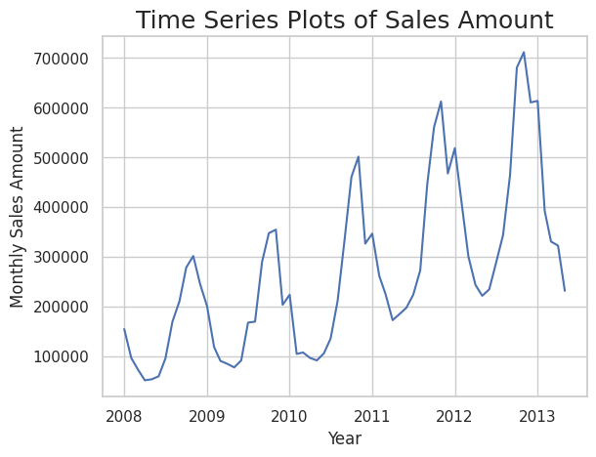
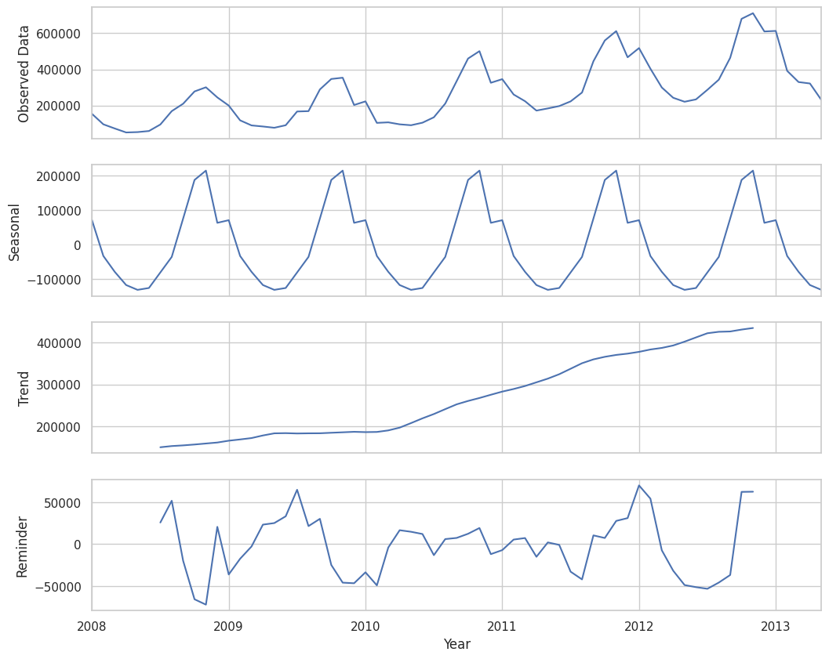

Understanding Time Series Data
Time series data is indexed in time order. Core components include trends, seasonality, cycles, and residuals. Examples are daily sales, monthly revenue, and annual growth. Data quality and preprocessing are essential.
Trends
Seasonality
Cycles
Long-term direction of the data.
Regular, predictable patterns.
Recurring but not periodic patterns.

Slide 3
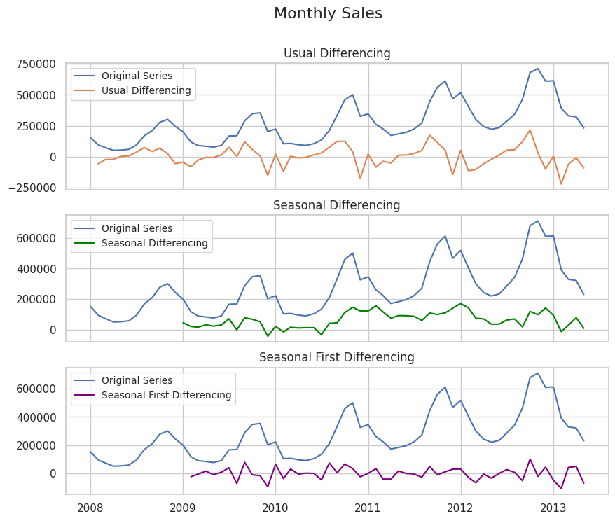
Core Time Series Methods
Use moving averages for smoothing and trend identification. Exponential smoothing weights recent data more heavily. The Holt-Winters method accounts for level, trend, and seasonality.
Simple Moving Average (SMA)
Exponential Moving Average (EMA)
Average of a fixed number of prior data points.
Weights recent data points higher than older data.

Slide 4
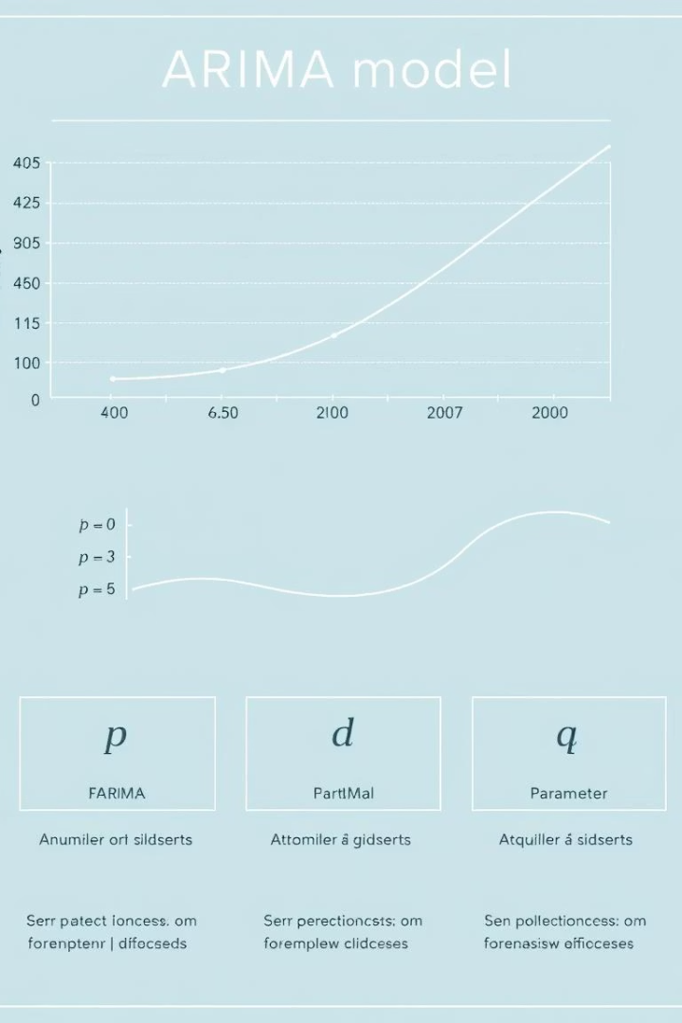



ARIMA Models: Autoregressive Integrated Moving Average
Key ARIMA parameters are p (autoregressive), d (integrated), and q (moving average). Steps include identification, estimation, and diagnostic checking. Use cases include sales forecasting and inventory management.
Autoregression (AR)
Uses past values to predict future values.
Integration (I)
Makes the time series stationary.
Moving Average (MA)
Models the error term as a linear combination of past error terms.

Slide 5
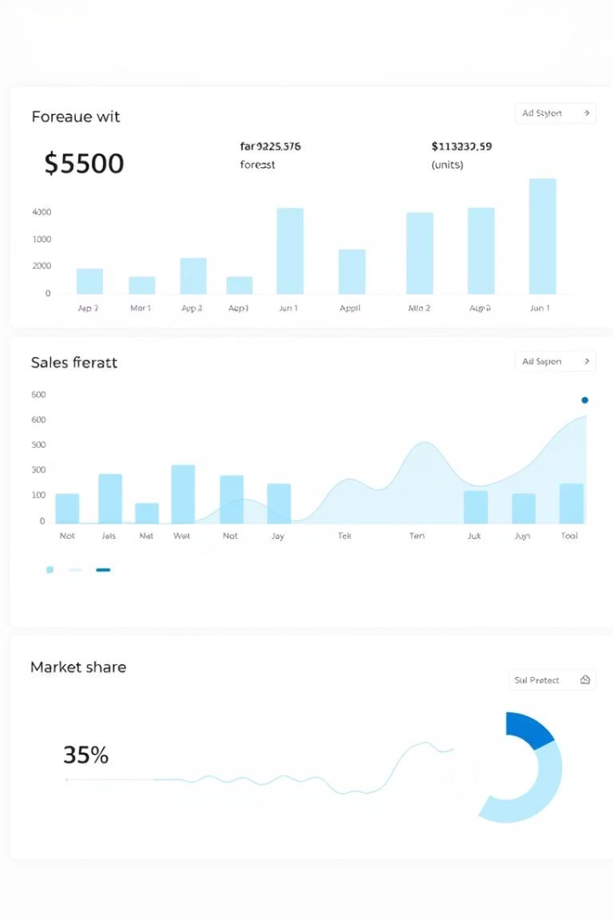
Evaluating Model Performance
Evaluate models using Mean Absolute Error (MAE) and Mean Squared Error (MSE). Also use Root Mean Squared Error (RMSE) and Mean Absolute Percentage Error (MAPE). Validate with in-sample vs. out-of-sample data. Visualize actual vs. predicted plots.
MAE
MSE
Average magnitude of the errors in a set of forecasts.
Average of the squares of the errors.
RMSE
Square root of the average of the squares of the errors.

Slide 6



Case Study 1: Retail Sales Forecasting
Monthly sales data was used for a department store (2015-2024). A seasonal ARIMA model was optimized with grid search. Results showed a 15% reduction in forecast error compared to the baseline.
Model Training
2
Train seasonal ARIMA model.
Data Collection
1
Gather monthly sales.
Optimization
3
Optimize model with grid search.

Slide 7
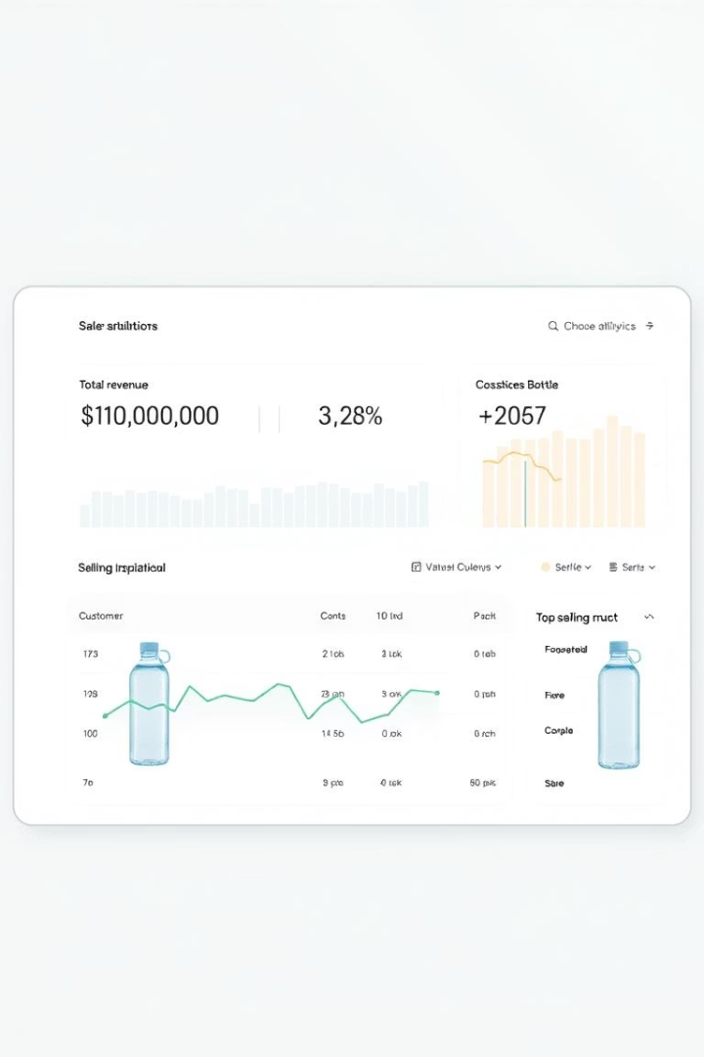
Case Study 2: E-commerce Sales Prediction
Daily website sales data was used for an online retailer (2022-2024). Exponential Smoothing with seasonality was used. Improved inventory planning and reduced stockouts by 20%.
1
Collect Daily Data
2
Apply Exponential Smoothing
3
Improve Inventory

Slide 8
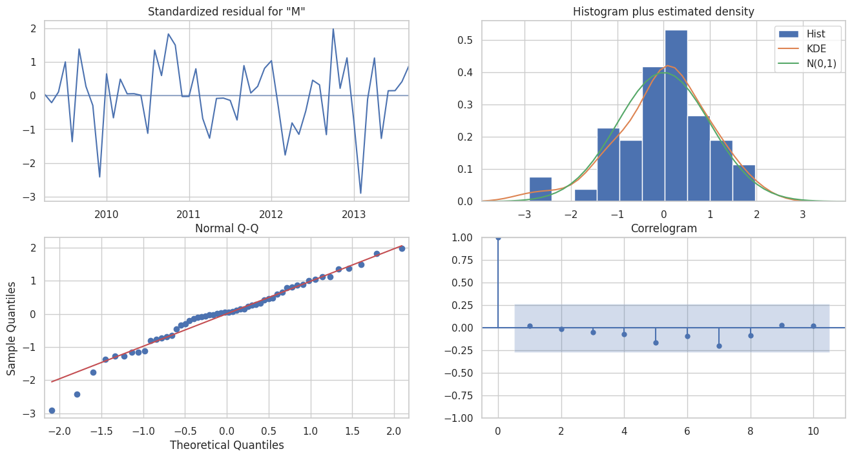



Advanced Techniques: Machine Learning Approaches
Use regression models like Linear Regression, Random Forest, and Gradient Boosting. Consider Neural Networks such as Recurrent Neural Networks (RNNs) and LSTMs. Engineer features like lagged variables and moving averages.
Regression
Neural Networks
Feature Engineering

Slide 9
Best Practices and Challenges
Prepare data by handling missing values, outliers, and anomalies. Select the right model for the data. Avoid overfitting models. Interpret forecasts and understand their limitations.
1
Data Prep
2
Model Selection
3
Avoid Overfitting

Slide 10
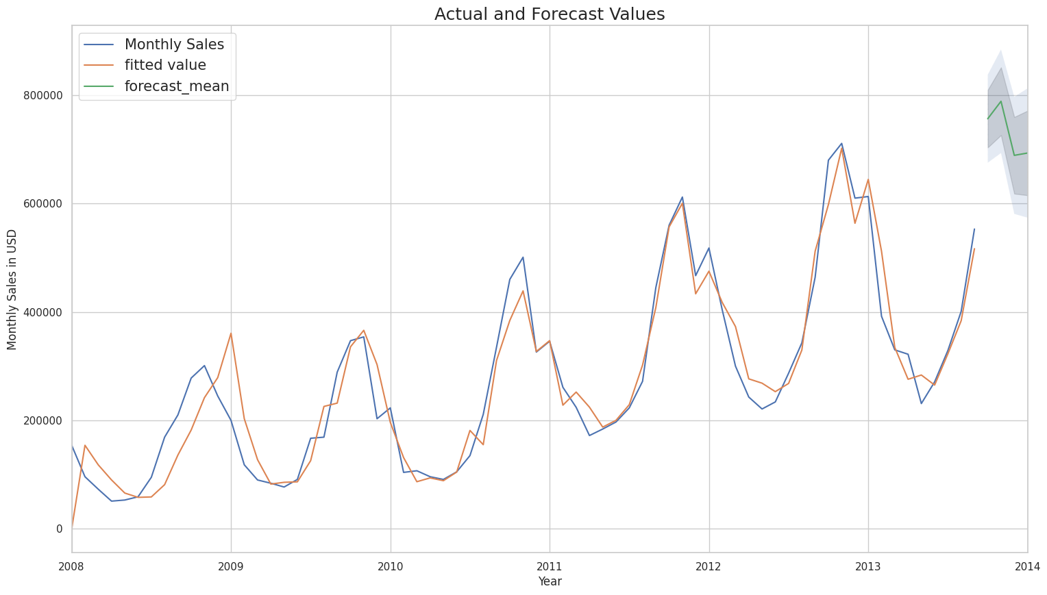
Conclusion: Harnessing the Power of Time Series Analysis
Time series analysis provides valuable insights. Data-driven sales forecasts improve decision-making. Continuous monitoring and refinement are crucial.
Insights
Decision-Making
Monitor
Gain valuable insights with time series analysis.
Improve decision making using forecasts.
Continuously monitor and refine models.

